Slide 1
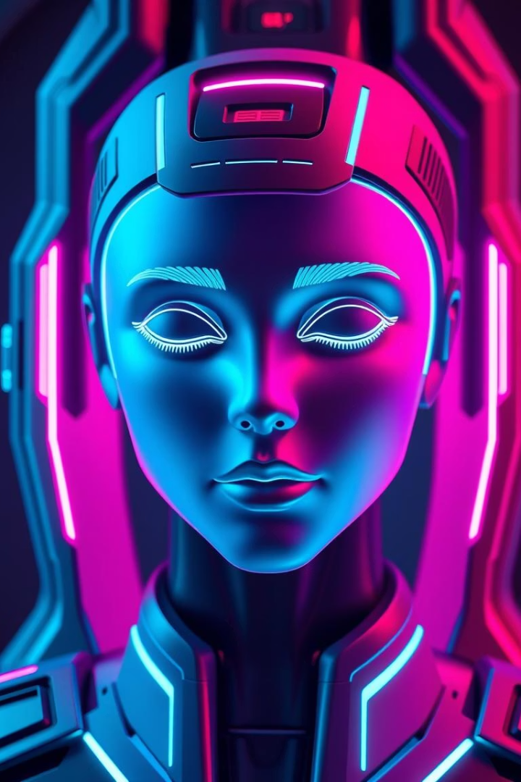

Multimodal Emotion Detection System
This presentation explores an innovative approach to detecting emotional states and monitoring alertness using advanced AI techniques. It will cover the utilization of Convolutional Neural Networks (CNN) to analyze visual data for emotion and fatigue recognition.
by Sarthak Mithaulia

Slide 2

Presentation Agenda
Introduction
Methodology
Results
Overview of the system and its purpose.
Tools, technologies, and processes used.
Outcomes, challenges, applications, and future scope.
This presentation will cover the motivation, objective, tools, technologies, dataset, data preprocessing, model architecture, emotion and drowsiness detection processes, results, challenges, applications, and future scope of the system.

Slide 3
Emotion and Drowsiness Detection System
Human Emotion Recognition
Drowsiness Detection
AI interprets emotions from facial cues, bridging machines and human understanding.
Technology identifies fatigue signs, crucial in high-risk environments.
This system utilizes Convolutional Neural Networks (CNN) to analyze visual data for emotion and fatigue recognition. It enhances safety and efficiency across various sectors, improves healthcare outcomes, and creates more responsive human-computer interfaces.

Slide 4
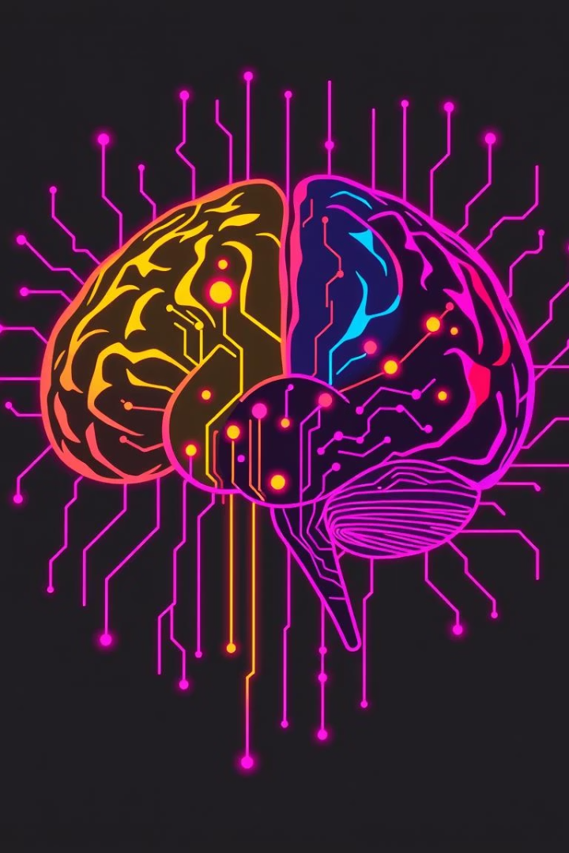



Motivation for the Study
Accidents
Emotion Detection
Increasing accidents due to drowsiness necessitate immediate interventions.
Capturing emotional states revolutionizes mental health, customer service, and user experience.
AI Assistants
Emotion detection enhances AI systems' responsiveness and effectiveness.
This research is driven by the need to address the growing number of accidents caused by driver fatigue and the importance of emotion detection in enhancing AI systems and monitoring systems to prevent accidents and promote safety.

Slide 5
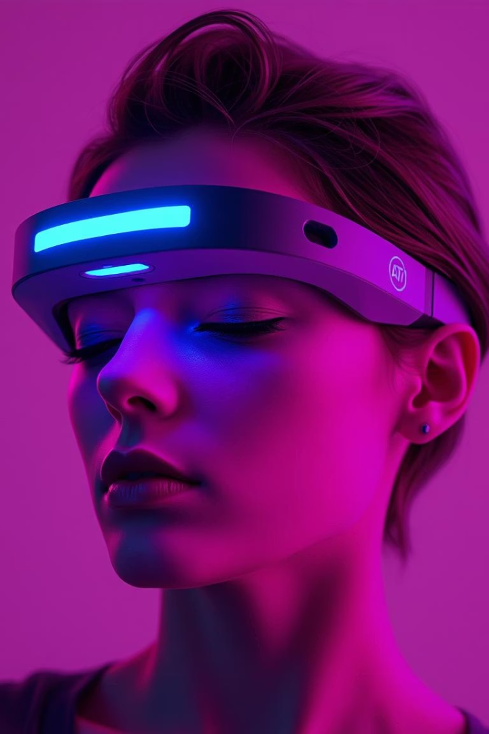



Objective of the Research
Real-time Emotion Detection
Recognize emotions with minimal latency.
Facial Expressions
Analyze emotions based on facial expressions.
Drowsiness Detection
Identify fatigue signs accurately.
The goals are to develop a system capable of recognizing human emotions in real-time, analyzing emotions based on facial expressions, and accurately identifying signs of fatigue to prevent potential accidents or hazards through eye closure analysis.

Slide 6




Tools and Technologies
Python
OpenCV
Keras
Python serves as the foundational programming language. OpenCV is an essential library for computer vision tasks. Keras with TensorFlow simplifies building and training CNN models. NumPy is used for numerical computing, and Pyttsx3 enables timely alerts for drowsiness detection outcomes.

Slide 7



Dataset Utilized
1
FER2013 Dataset
2
48x48 Grayscale
3
Seven Emotions
The FER2013 dataset is used for training, containing labeled facial expression data for diverse emotions. Images are processed to 48x48 pixels in grayscale, optimizing data input for CNN training. The dataset categorizes emotions into seven distinct types, allowing for a nuanced understanding of human sentiment.

Slide 8




Data Preprocessing Steps
Grayscale Conversion
Transform colored images into grayscale.
Resizing
Standardize images to 48x48 pixels.
Normalization
Enhance data by normalizing values.
Data is prepared for effective model training through grayscale conversion, resizing to 48x48 pixels, normalization, augmentation, and segregation into training and testing sets to ensure unbiased evaluation of model performance post-training.

Slide 9
Model Architecture
1
CNN Layers
2
MaxPooling
3
Dropout
The model architecture utilizes stacked CNN layers to learn from visual data, convolutional layers for feature extraction, max-pooling layers for downsampling, dropout layers for regularization, and dense layers with softmax activation for multi-class classification, enabling the system to categorize real-time emotions effectively.

Slide 10




Applications and Future Scope
Healthcare
Automotive
Robotics
This system has applications in healthcare, automotive, and robotics. Future scope includes enhancing the model's accuracy, expanding the range of detectable emotions, and integrating the system into various real-world applications to improve safety, efficiency, and user experience.

Slide 11
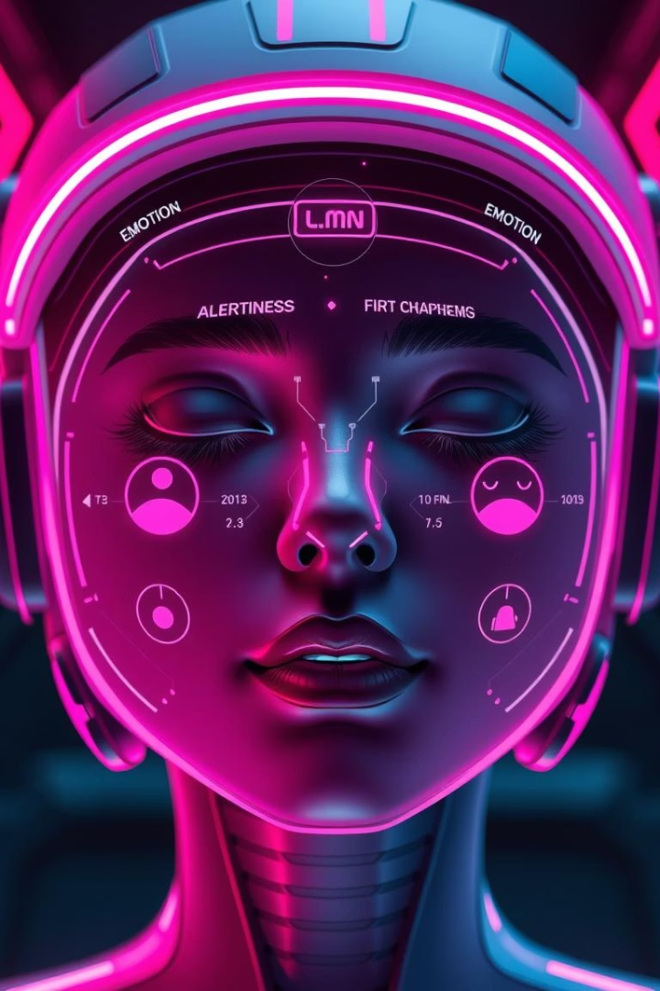
Real-Time Emotion and Drowsiness Detection System
This presentation outlines our deep learning approach to real-time emotion and drowsiness detection. We'll cover the model architecture, detection processes, results, challenges, applications, and future scope. Our system aims to provide instant feedback and awareness, crucial for practical applications in various environments.

Slide 12
Model Architecture
CNN Layers
Multi-class Classification
Stacked layers configured to learn from visual data, capturing intricate features within images.
Enables the system to categorize real-time emotions effectively based on input images.
Conv2D and MaxPooling for feature extraction
Dropout for regularization
Dense Layers with Softmax Activation for multi-class classification

Slide 13
Conv2D (Convolutional Layer):
It applies filters (kernels) to input images to detect patterns like edges, curves, and textures.
Each filter slides over the image, producing a feature map that highlights specific features.
Helps the model learn spatial hierarchies (e.g., from simple edges to complex facial patterns in emotion detection).
Example : If you're detecting "anger", Conv2D might detect tight eyebrows or frown lines
MaxPooling (Pooling Layer):):
It reduces the size of feature maps by keeping only the most important information.
For each region, it picks the maximum value (hence the name MaxPooling).
This makes the model faster and more resistant to small shifts or noise in the image.
Example: Even if the face moves slightly in the webcam, MaxPooling helps the model stay accurate.

Slide 14
Dropout for Regularization
Dropout is a technique used to prevent overfitting in neural networks.
It randomly deactivates a fraction of neurons during training, forcing the network to learn more robust features.
This improves the model's generalization to new, unseen data.
2.Dense Layers with Softmax Activation for Multi-Class Classification
Dense (Fully Connected) Layers combine all extracted features to make final predictions.
The Softmax activation function at the final layer converts raw prediction scores into probabilities.
It’s ideal for multi-class classification, where the model must assign the input to one of several categories (like happy, sad, angry, etc.)

Slide 15
3. Additional CNN Layer Components (optional, for more depth):
a. Batch Normalization
Normalizes the inputs of each layer to speed up training and reduce sensitivity to initialization.
Helps the model train faster and generalize better.
b. ReLU Activation
Stands for Rectified Linear Unit.
Adds non-linearity, helping the network learn complex patterns.
Commonly used after each Conv2D layer.
c. Flatten Layer
Converts the 2D matrix of features into a 1D vector before passing it to the dense layers.
Acts as a bridge between the convolutional layers and the fully connected layers.

Slide 16
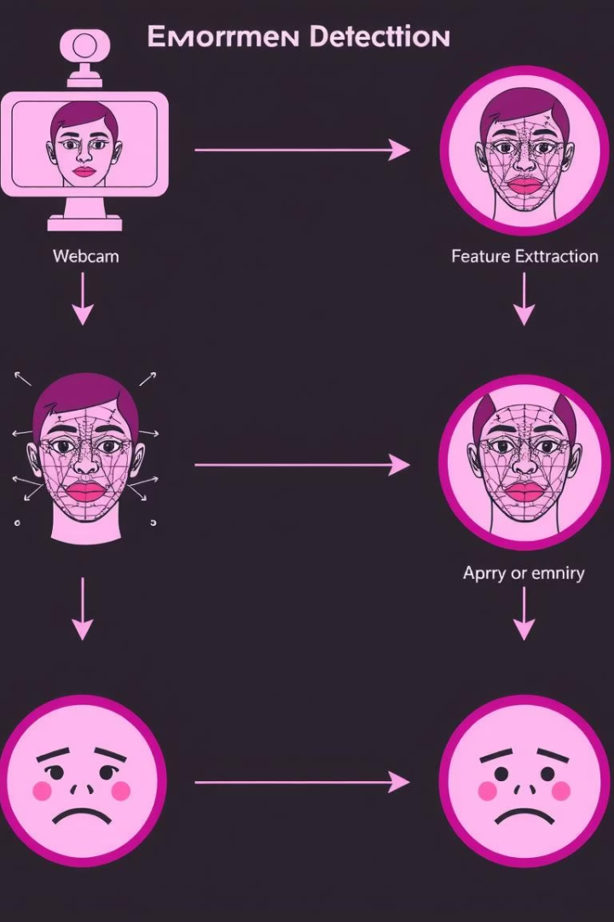




Emotion Detection Process
Input
Real-time inputs from cameras or pre-recorded videos to continuously analyze emotional states.
Face Detection
Employing Haar cascades as a swift face detection tool, ensuring the focus on facial features during emotion recognition.
Prediction
Leveraging pre-trained Convolutional Neural Networks to classify emotional states based on facial input analysis.
Display
Outputting the predicted emotion label to users instantly, fostering interaction and awareness.

Slide 17
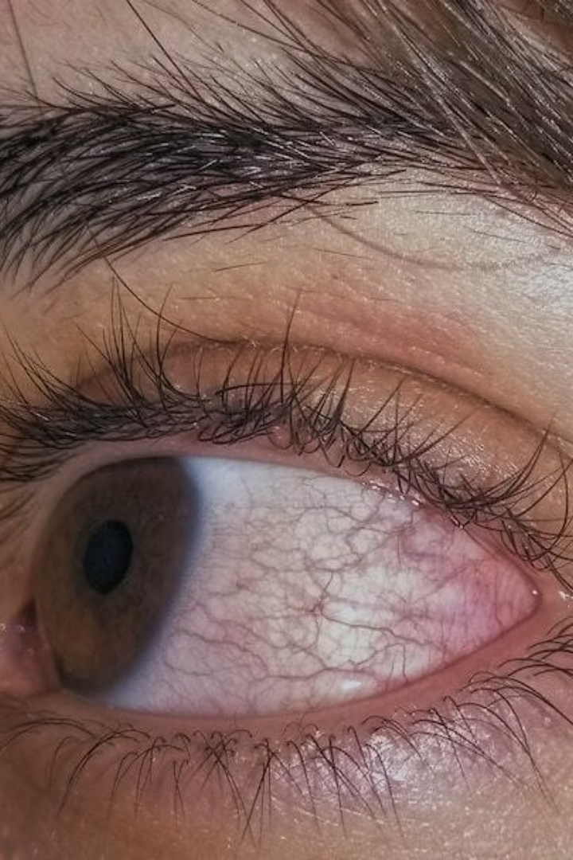




Drowsiness Detection Process
Eye Detection
Implementing rapid eye detection techniques to determine visible eye states during assessments for drowsiness.
Count Visible Eyes
Quantifying the number of detected eyes to ascertain user alertness and potential drowsiness levels.
Trigger Timer
Initiating a monitoring timer when the eye count falls below a designated threshold, prompting alert protocols.
Voice Alert
Generating audible alerts for the user when drowsiness is detected, utilizing text-to-speech technology for instant feedback.

Slide 18
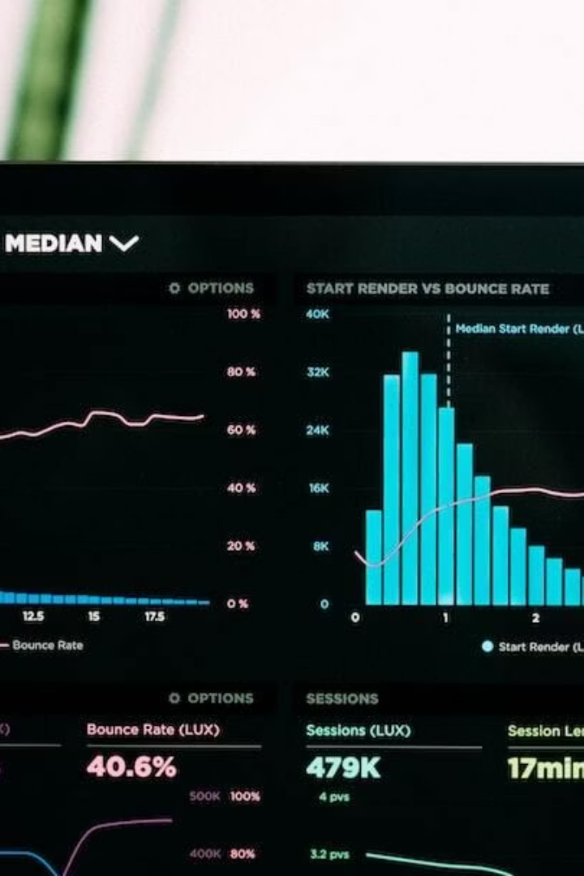



Results of the System
High Accuracy
Real-time Prediction
Results demonstrate a significant level of accuracy in predicting emotions and detecting drowsiness during trials.
The system exhibits capability for instant prediction and feedback, crucial for practical application in real-time environments.
Voice Alerts
Confirmed effectiveness of voice alerts in engaging users and providing timely notifications during drowsiness situations.

Slide 19
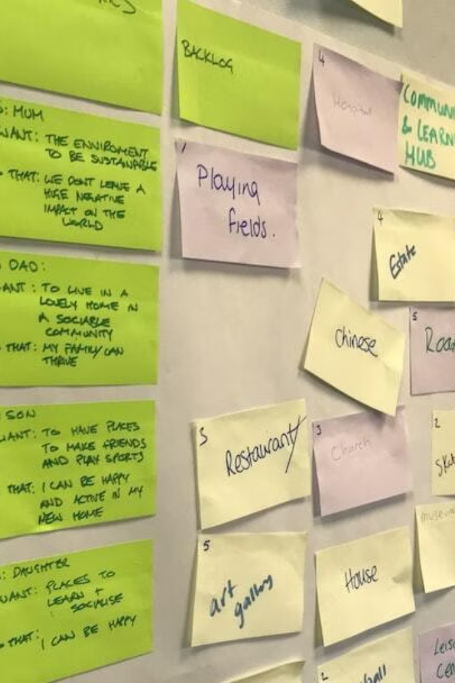
Challenges Faced During Development
Model Compatibility
OpenCV GUI Errors
Bugs and interface errors during implementation of OpenCV for facial detection required troubleshooting.
Ensuring compatibility across different versions of libraries and dependencies complicated integration.
Training Time
Significant model training times due to resource constraints highlighted the need for more powerful computational setups.

Slide 20





Applications of the Detection System
Driver Drowsiness Detection
Student Engagement Monitoring
Emotion-Aware Virtual Assistants
Prevent accidents by monitoring driver drowsiness in real-time.
Measure student attention and engagement levels during learning.
Enhance virtual assistants to respond appropriately to users' emotions.
Surveillance Systems
Detect emotional states or alertness levels in monitored areas.
Our detection system has diverse real-world applications, from enhancing safety in automotive contexts to improving engagement in educational settings. By integrating emotion and drowsiness detection, we can create more responsive and intelligent systems across various industries.

Slide 21

Future Scope of the System
Improve Model Accuracy
Continuous refinement of the model utilizing larger datasets and advanced techniques to enhance prediction accuracy.
Integrate Yawning Detection
Extending capabilities to include yawning detection as another critical indicator of drowsiness.
Mobile/IoT Application
Plans to develop a mobile or IoT version of the system to enhance accessibility and usability.

Slide 22
Thank you for your time!
contact info:
Email: sarthakmithaulia04505@gmail.com
+919696169565 | github.com/sarthakmithaulia | linkedin.com/in/sarthak-mithaulia9008

